Slide 1

AJAX-7
SHARMA COMPUTER ACADEMY

Slide 2
Sending post request
By default the Fetch API sends a GET request.
However it can also be used to send HTTP POST requests

Slide 3
Sending post request
But for POST request we have to send another object as the second argument to fetch() with the following structure/properties:
{
method: ......,
headers: .....,
body: ......
}

Slide 4
Sending post request
Following are the details of these properties:
method: A string that specifies which HTTP method to use in the request
body: A string with any data we want to give to the server in our request
headers: An object that allows us to add any headers we want our HTTP requests to include

Slide 5
What is passed to headers?
For the property 'headers’ ,which accepts an object , we pass a key called ‘Content-Type’ indicating the type of data we are sending to the server.
It’s possible values are:
application/json
text/plain
application/x-www-form-urlencoded
multipart/form-data

Slide 6
What is passed to headers?
Now since in most of the cases we send JSON data , so the value of headers becomes:
headers: { 'Content-Type':'application/json'}

Slide 7
What is passed to body?
Since we want to send JSON data to the server , we must convert our value / object to a JSON string.
This is done by calling JSON.stringify() method and passing it the value/object to be converted as argument.

Slide 8
What is passed to body?
So the code looks like:
body: JSON.stringify(data)

Slide 9
Response for post request
In case of POST request , the server usually returns a status code of 201.
This is an HTTP status code which represents that a new resource has been CREATED at the server

Slide 10
How to check for error ?
Since we get status code as 201 , so , we can directly check for it as follows:
if (response.status !== 201) {
console.log("Error in response!");
} else {
return response.json();
}

Slide 11
How to check for error ?
Alternatively we can check for response.ok which is a shorthand for checking that status is in the range 200-299 inclusive and returns a boolean value
if (response.status !== response.ok) {
console.log("Error in response!");
} else {
return response.json();
}

Slide 12
Exercise
Write an Fetch API based application to send USER DETAILS
to the REQ-RES API . It should include first_name,last_name
and job_title .
Finally print the response returned by the server which
contains ID and TIMESTAMP
The url to be requested is: https://reqres.in/api/users

Slide 13
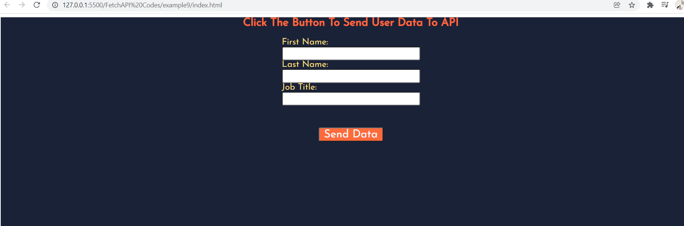
Desired output

Slide 14
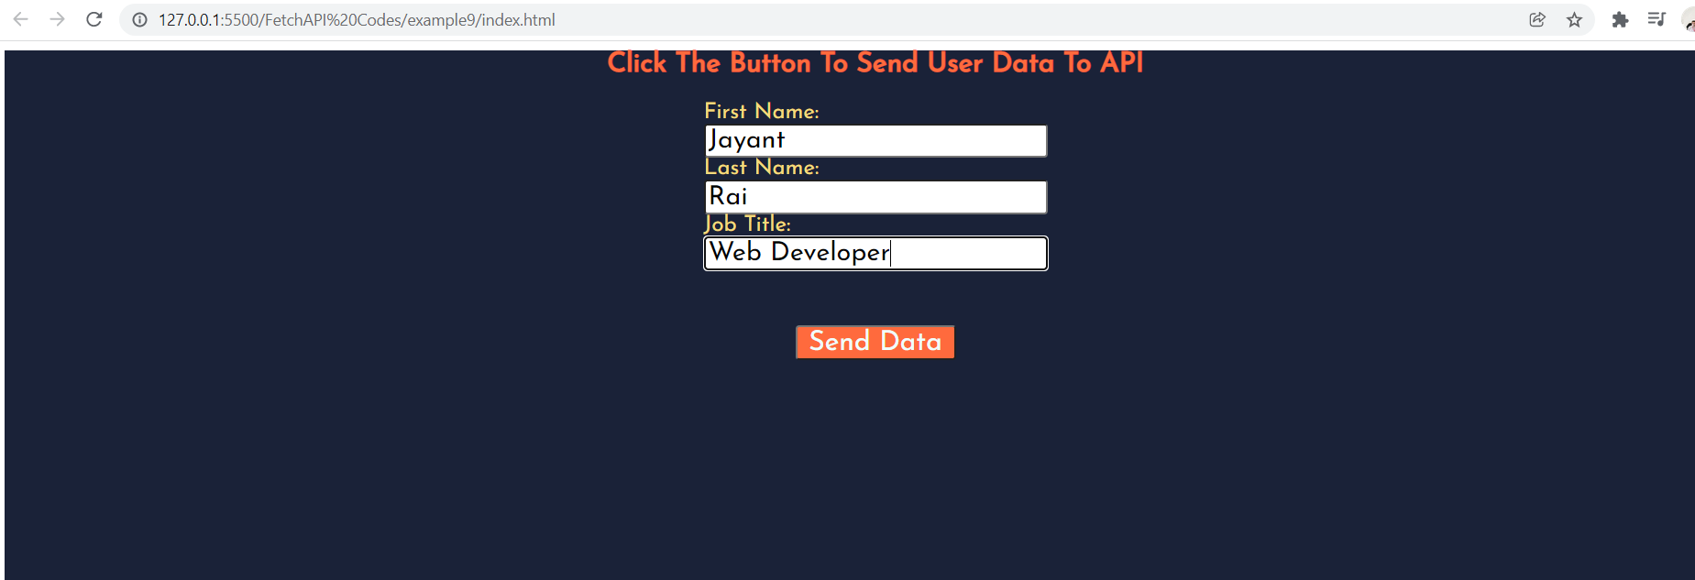
Desired output

Slide 15

Desired output

Slide 16
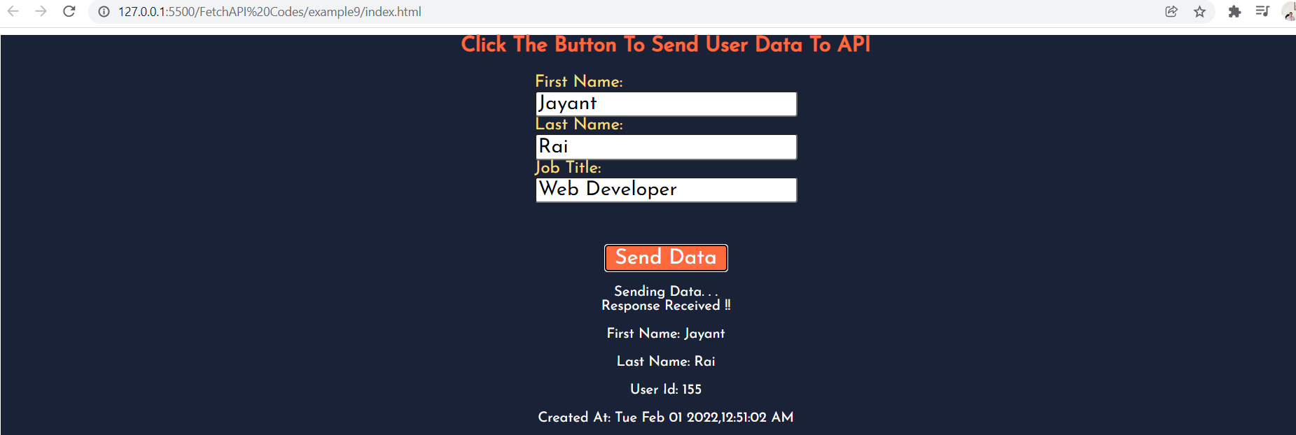
Desired output

Slide 17

Thanks!
Any questions?
You can find me at:
Email id: info@scalive.in
Contact no. : +917314853128

